Slide 1
Agile Data Platform
Introduction to agile architecture

Slide 2
Why a different architecture?
Team size
Number of teams
Dependencies
Complexity

Slide 3
Coupling
Tightly coupled architecture vs loosely coupled
Swap out and change
Evolution and competition

Slide 4
Encapsulation
Everything self contained
Single deliverable, single purpose

Slide 5
Data Products
Contract
Design for discoverability

Slide 6
Avoid the Empire
Decentralisation reduces large complex projects
Catalogue/data lineage is a good example
Unnecessary
People can discover, NHS is a great example
Lineage can be written into the data, more discoverable and harder to break

Slide 7
Requirements
Rethink what is a real requirement and what is just the way it’s done
Identity
Does it need to be centralised? Introduces change controls and slows progress
Catalog
Does a central catalogue add anything? Sharepoint sites can be more discoverable for real users looking for data
Glossary
Standard words can be useful within a business but don’t scale well and often different BUs use different terms for good reasons. Do we need two weeks of workshops to decide between product, SKU, item, bundle etc. or should we just pick a term and run with it, changing where necessary later

Slide 8
Patterns
A Data platform has no required components
Start from a blank sheet and add what’s needed
Skills are more useful than patterns

Slide 9
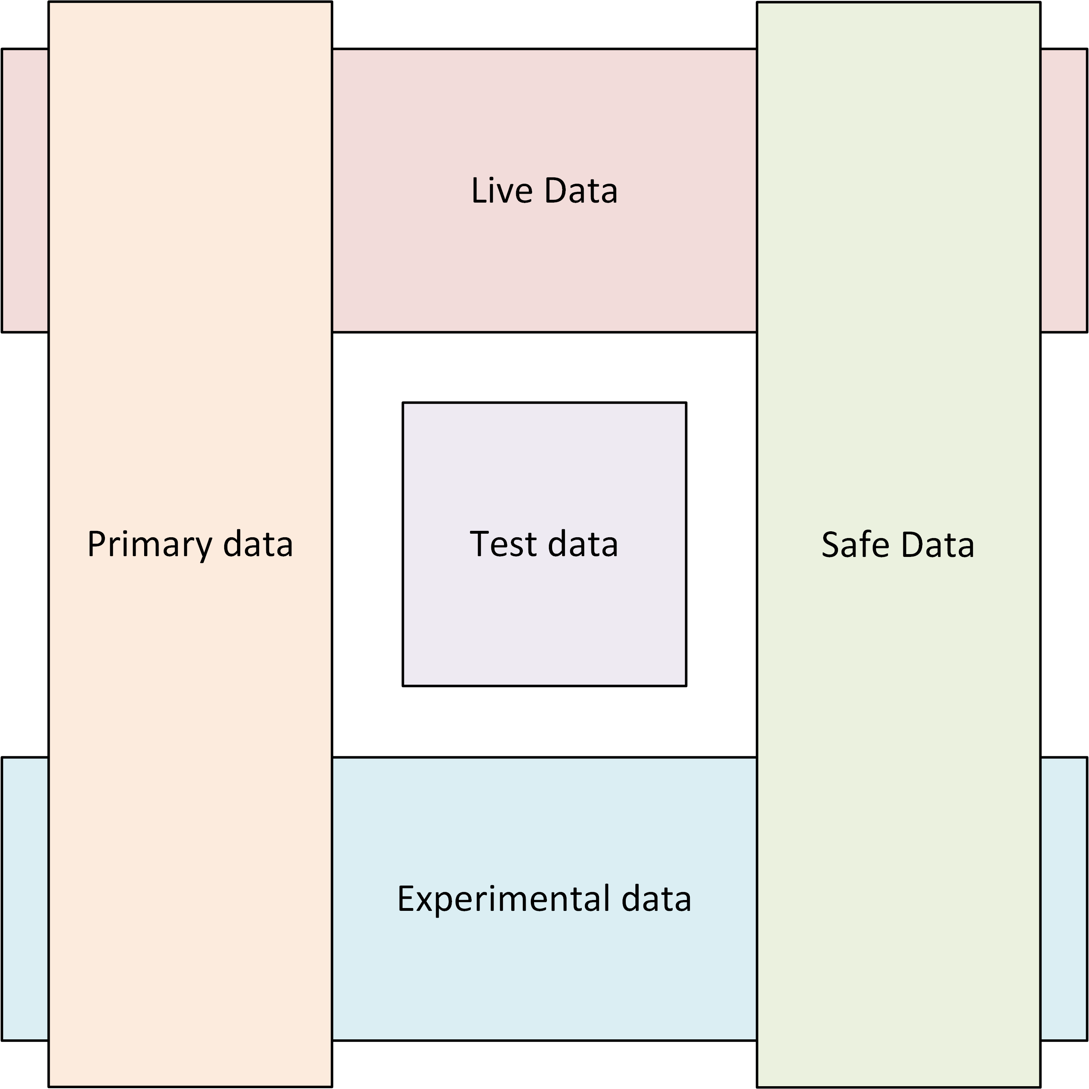
Data Classification vs Staging

